Slide 1
UHMC – Financial Outlook
August 6, 2020

Slide 2
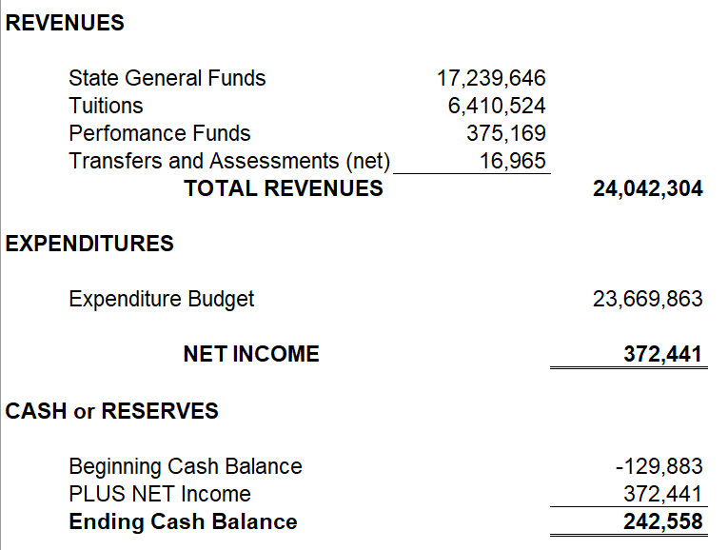
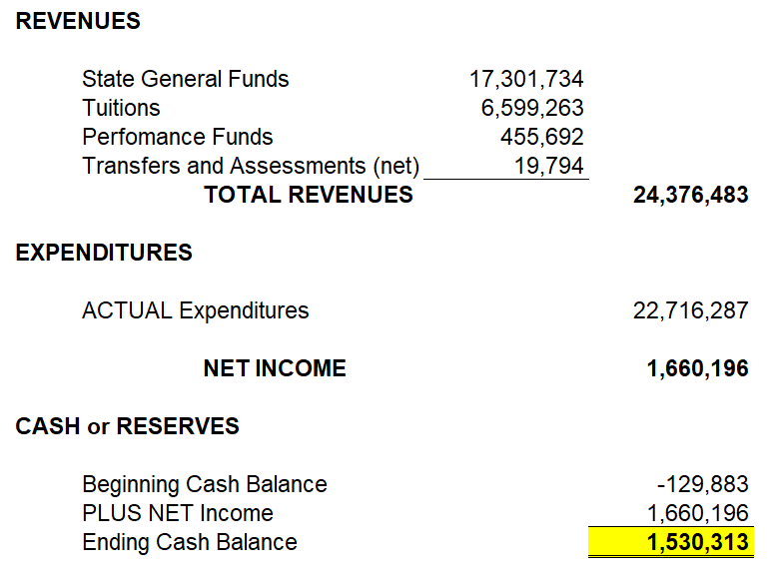
FY 2020 Initial Budget Proposal
FY 2020 Actual Results (in reconciliation)

Slide 3
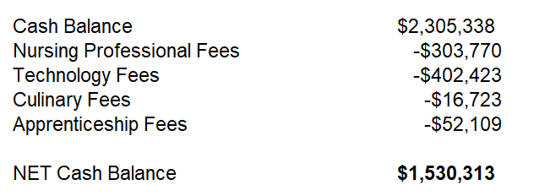
NET ENDING CASH BALANCE

Slide 4
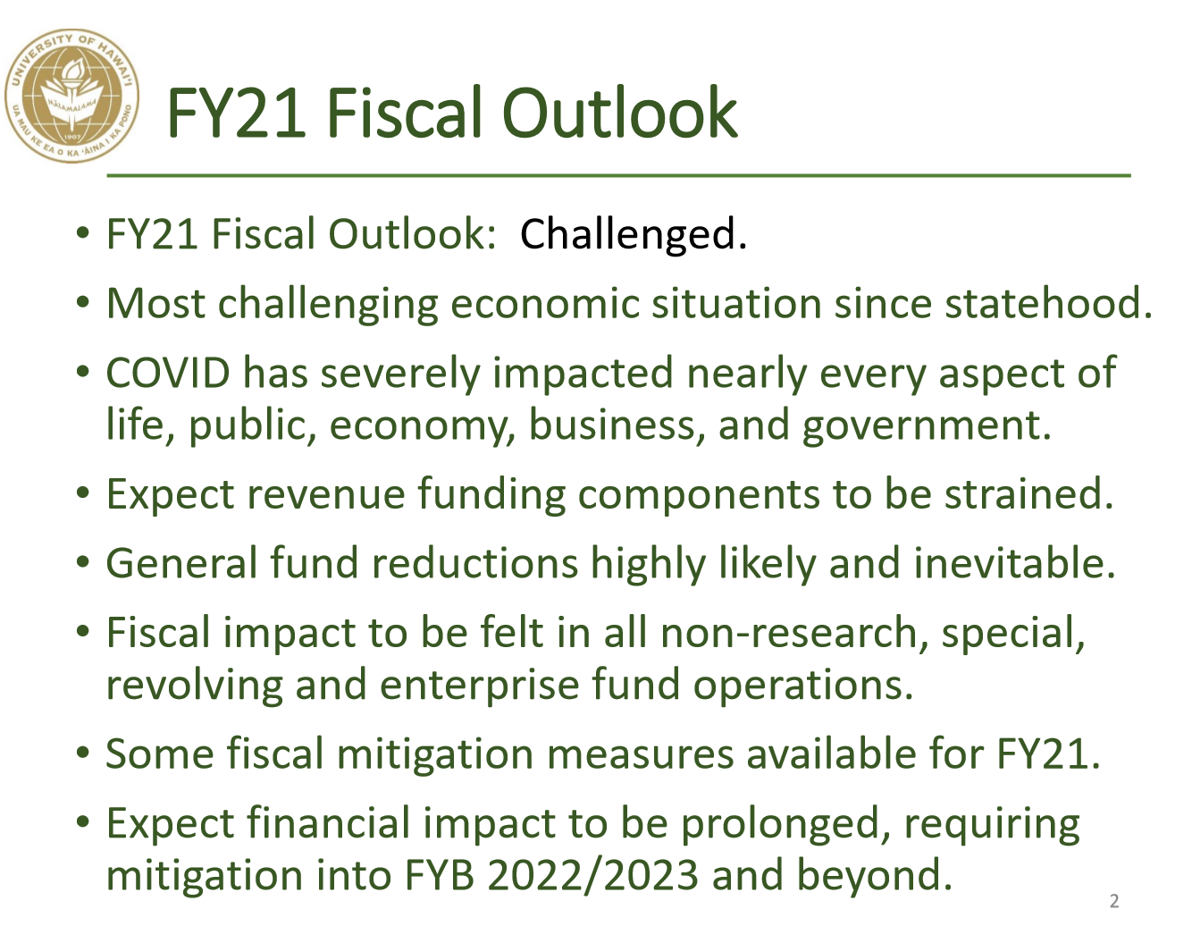
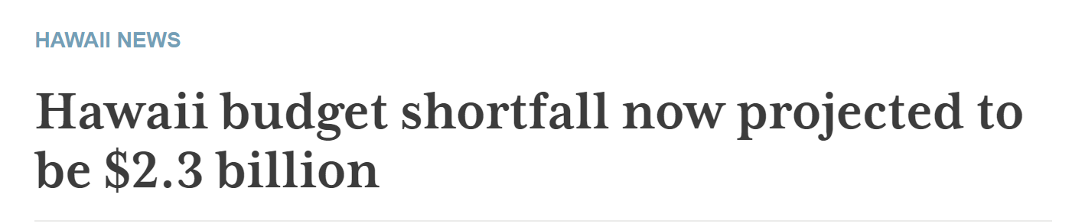
Slide from UH VP Kalbert Young’s 8-6-20 BOR Presentation

Slide 5
State Legislature – HB2200
29 vacant UHMC positions swept
10 Instructional Faculty
3 Maui Food Innovation Center
4 Student Services
2 Business Office
1 VCAS Secretary
1 University Center
1 Librarian
7 Operations and Maintenance

Slide 6
Instructional Faculty - Positions
Art
Accounting
Business
Spanish
Drama
Molokai Farm
2 Math
2 Allied Health

Slide 7
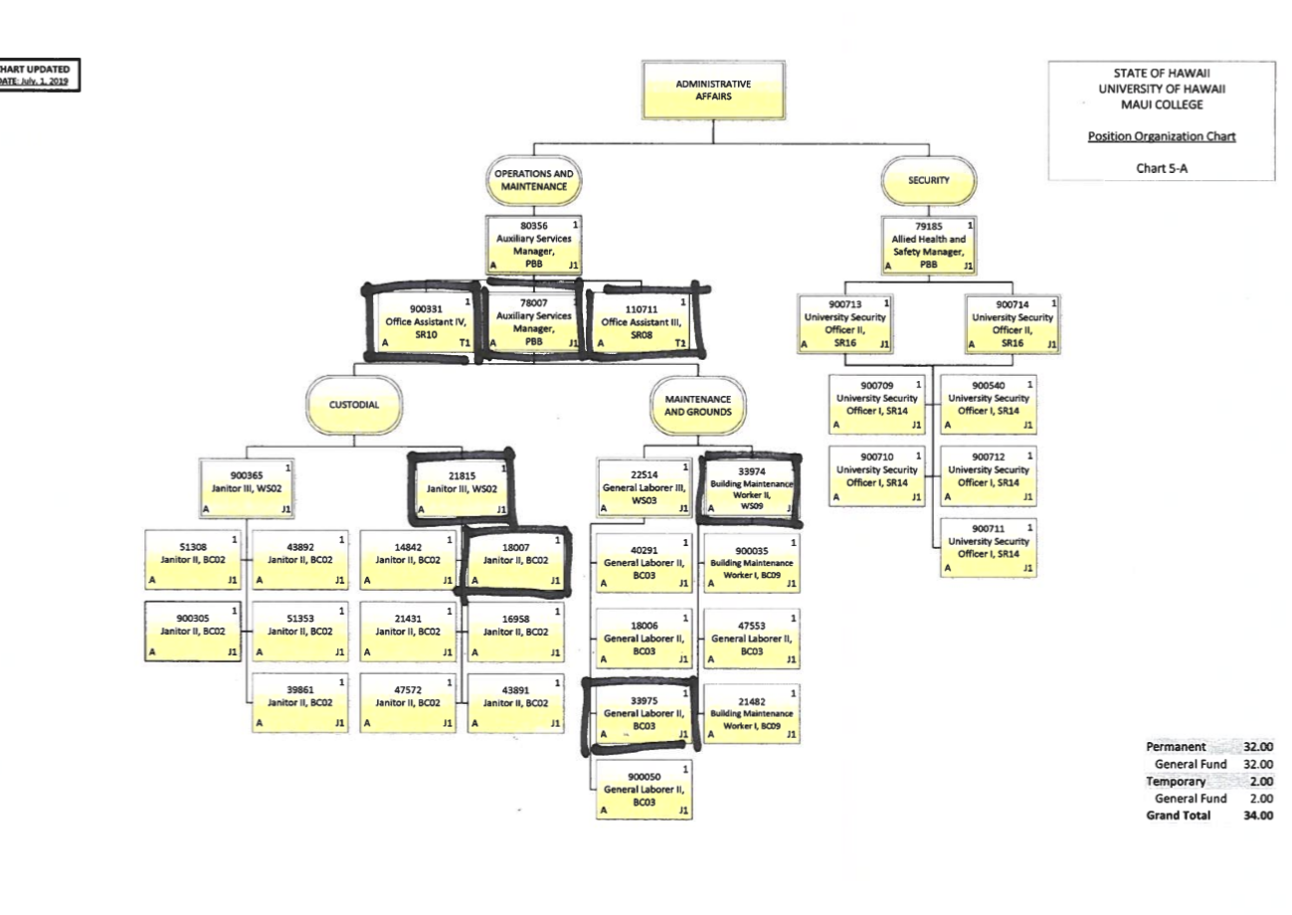
Impact to O&M

Slide 8
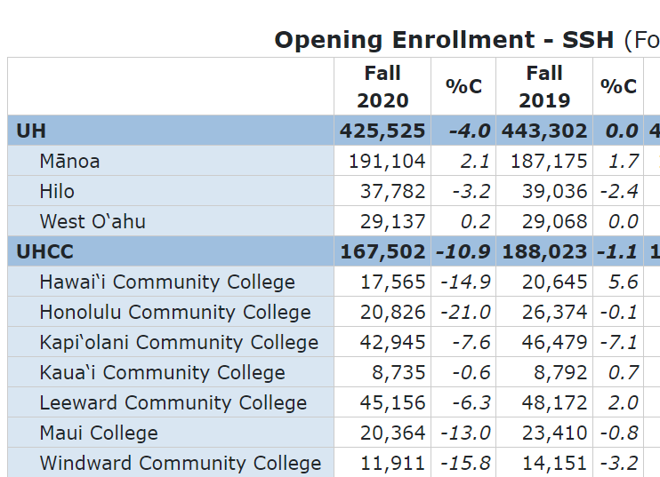
UHMC – Major Funding Sources
State General Funds – if reduced by 16% - $2,750,000 - hypothetical
Tuition and Fees -13% down -$810,000
Other Special Funds
ELWD
Foodservice
Summer Session

Slide 9
While the College has NOT received any budget instructions – a hypothetical 16% General Fund reduction and a 13% enrollment decline would amount to a $3.6M Operating Budget reduction.
Does NOT include Special Fund losses

Slide 10
Short term budget strategies:
Freeze ALL Remaining Vacant Positions
Reduce Lecturer Budget by 26%
Eliminate Casuals
Eliminate Student Assistants
Eliminate Travel Budgets
Delay Start of New Programs
Delay Large Contracts
No Equipment and Library Resources
Reduce Remaining Operating Expenses by 25%
Total Estimated Reduction $3,600,000
Draw down on $1.5M cash balance

Slide 11
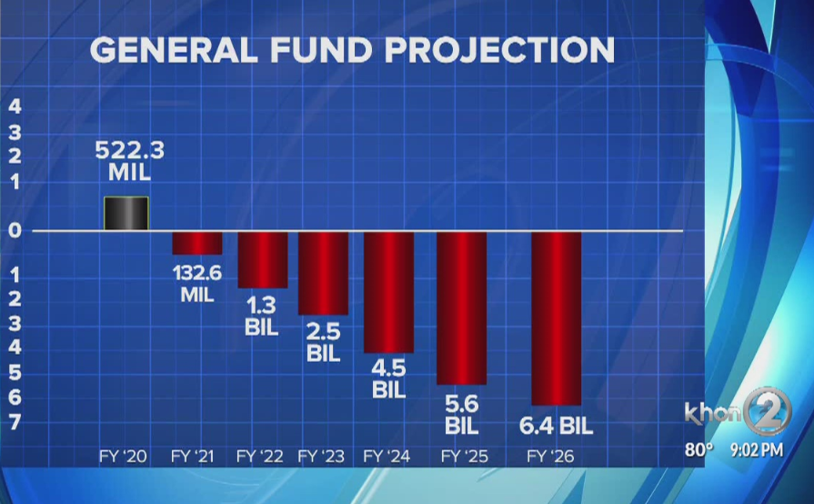
State Forecast – Next 6 Years

Slide 12
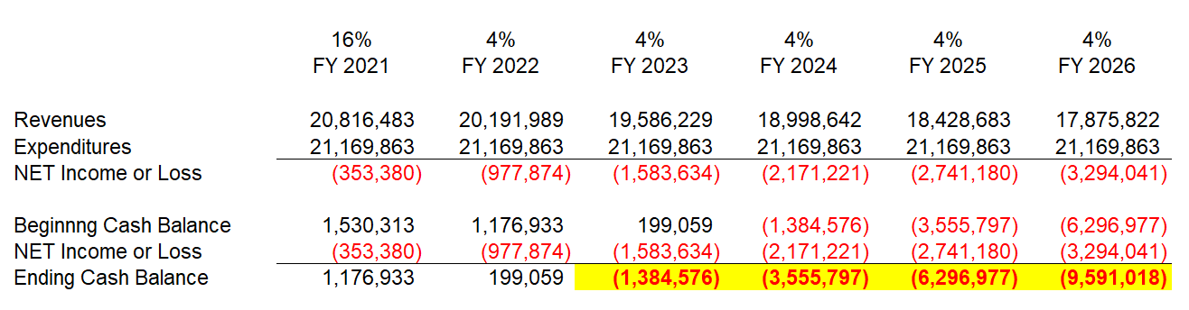
UHMC – 6 Year Forecast (4% General Fund Reductions)

Slide 13
Long term strategies
Changes in Higher Education
Maui’s Economic and Workforce Development
UH and UHMC - Restructuring and Reorganization
Centralization
Consolidation
State implemented furloughs
Enrollments
Extramural funds
Revenue generating opportunities

Slide 14



