Slide 1
Smart Robots, Drones, IoT
Debasis Bhattacharya, JD, DBA
University of Hawaii Maui College ATE 2018 – Demonstration
debasisb@wawaii.edu
http://maui.hawaii.edu/cybersecurity
October 25, 2018

Slide 2
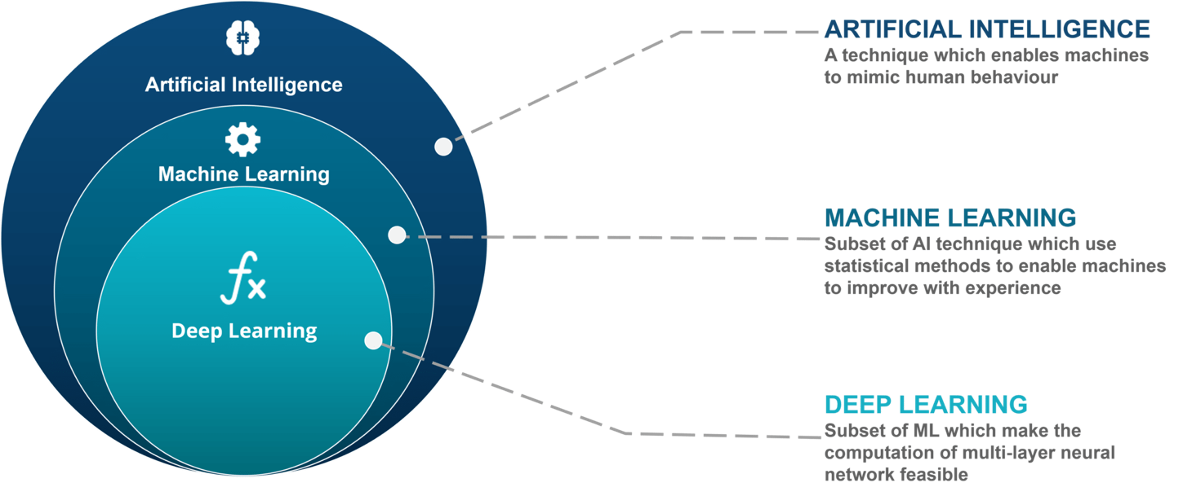
Source: Edureka

Slide 3
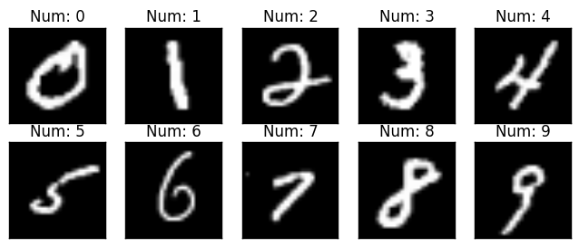
Source: TensorFlow for R - RStudio

Slide 5
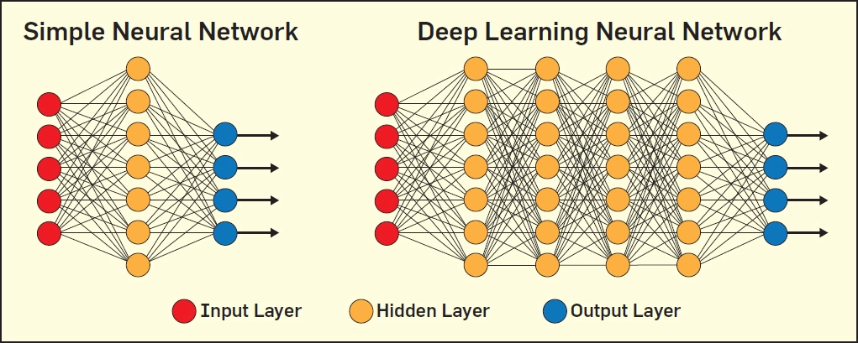
Source: ACM - Computers in Entertainment - Association for Computing Machinery

Slide 6
Convolutional Neural Network - ConvNet
Source: https://ujjwalkarn.me/2016/08/11/intuitive-explanation-convnets/

Slide 7
Image - Matrix of Pixels
Channels - Color images have 3 channels - RGB. Each Pixel Value ranges from 0 to 255
Grayscale Image - One channel, values 0 (white) to 255 (black)
Source: https://ujjwalkarn.me/2016/08/11/intuitive-explanation-convnets/

Slide 8
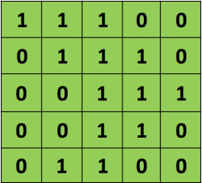
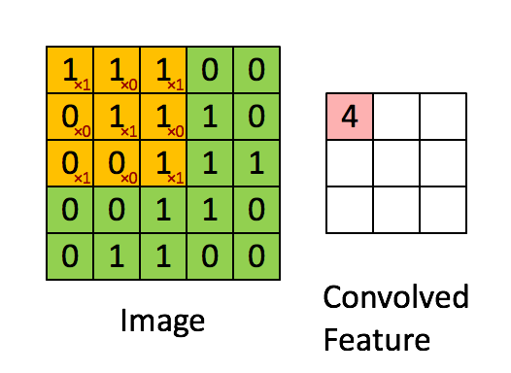
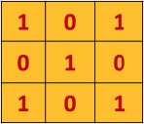
Convolution - Extract Features
3x3 Filter, or Kernel or Feature Detector
Input Image, 5x5
Move 3x3 Filter over 5x5 Input Image, one pixel at a time (STRIDE) and compute matrix multiplication. Convolved Feature or Feature Map
Source: https://ujjwalkarn.me/2016/08/11/intuitive-explanation-convnets/

Slide 9
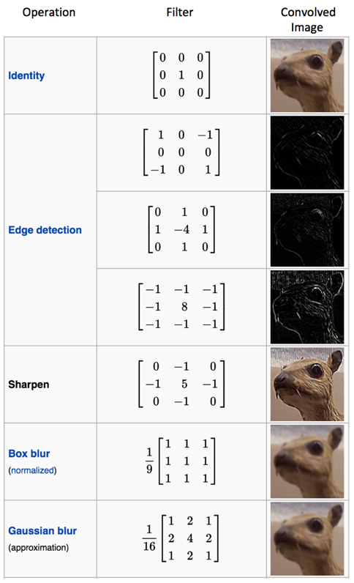
Different values of the Filter or Kernel will create different Feature Maps from the Input Image
Examples of Features - Edges, Blurs, Sharpen
Parameters
Depth - # of Filters
Stride - movement across image Zero-Padding - apply filter to edges
Source: https://ujjwalkarn.me/2016/08/11/intuitive-explanation-convnets/

Slide 10
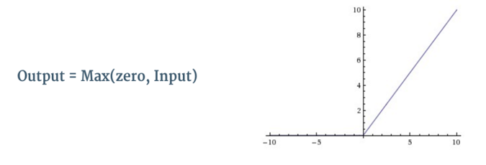
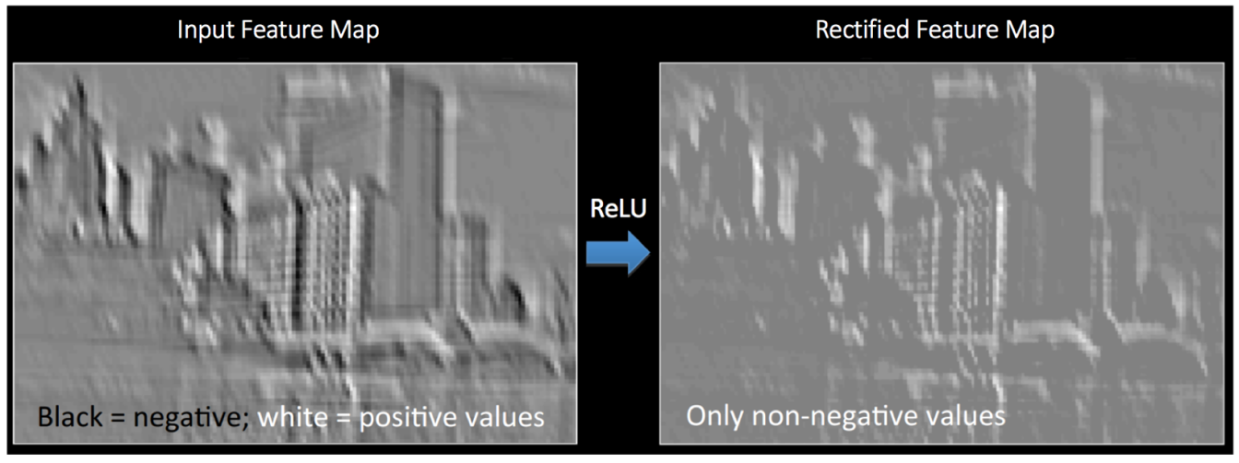
Non-Linearity - Rectified Linear Unit (ReLU)
Introduce non-linearity to Feature Map. Replace negative values of pixels with zero

Slide 11
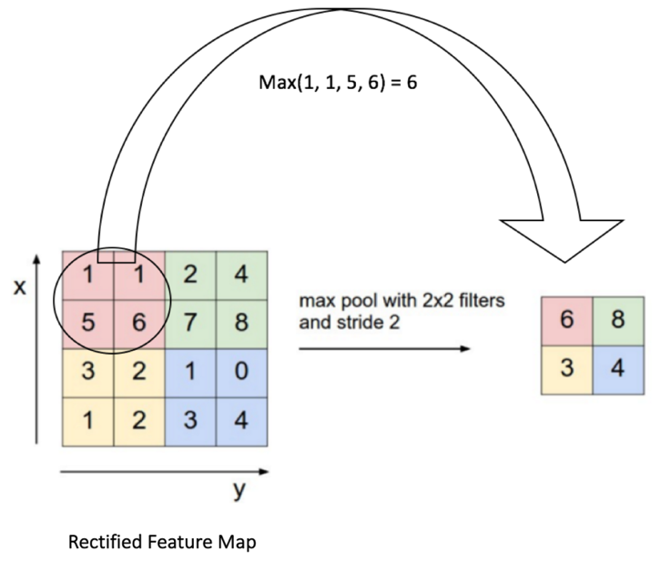
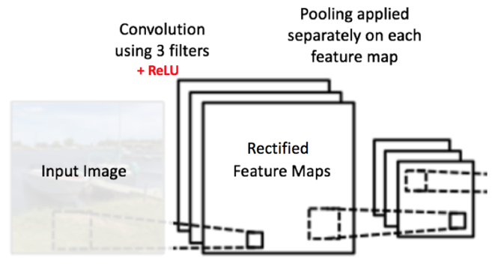
Pooling
Reduce Dimensionality
Reduce computations, controls Overfitting
Allows for small distortions in image
Helps detect objects in any part of image
Source: https://ujjwalkarn.me/2016/08/11/intuitive-explanation-convnets/

Slide 12
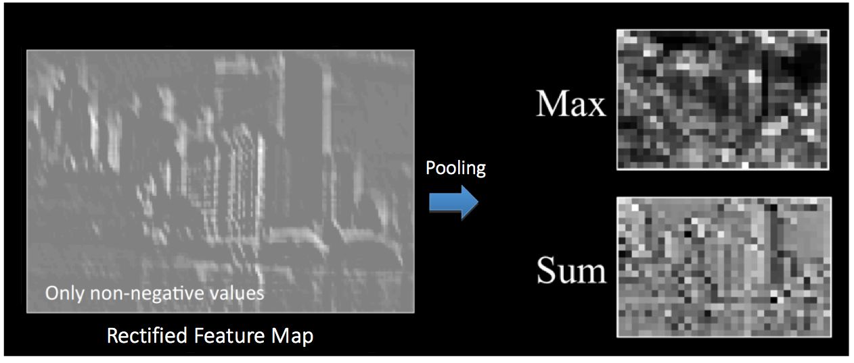
Pooling - Max or Sum
Source: https://ujjwalkarn.me/2016/08/11/intuitive-explanation-convnets/

Slide 13
Fully Connected Layer (FCNs)
Rectified and Pooled Feature Maps are connected together into on FCN
Training Data Set is used to Classify Image
SoftMax Activation Function used to create vector of values between 0 and 1
Source: https://ujjwalkarn.me/2016/08/11/intuitive-explanation-convnets/

Slide 14
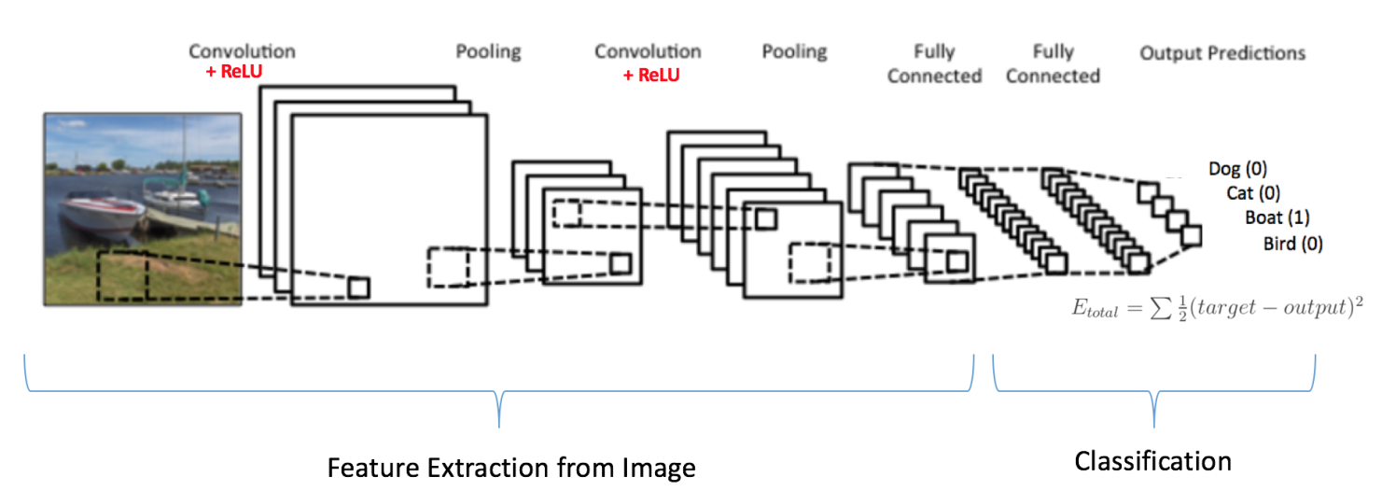
Forward Propagation
Source: https://ujjwalkarn.me/2016/08/11/intuitive-explanation-convnets/

Slide 15
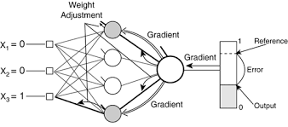
Backward Propagation
Calculate Gradient of error
Use Gradient Descent to update filter weights
Reduce Output Error or Training Loss
Epoch = Forward + Backward Propagation
Hyperparameter = Learning Rate
Validation Data -> Forward Propagation Only
Minimize Training Loss & Validation Loss
Control Overfitting using Dropouts
Allow for Generalization of New Test Data
Source: https://ujjwalkarn.me/2016/08/11/intuitive-explanation-convnets/

Slide 16
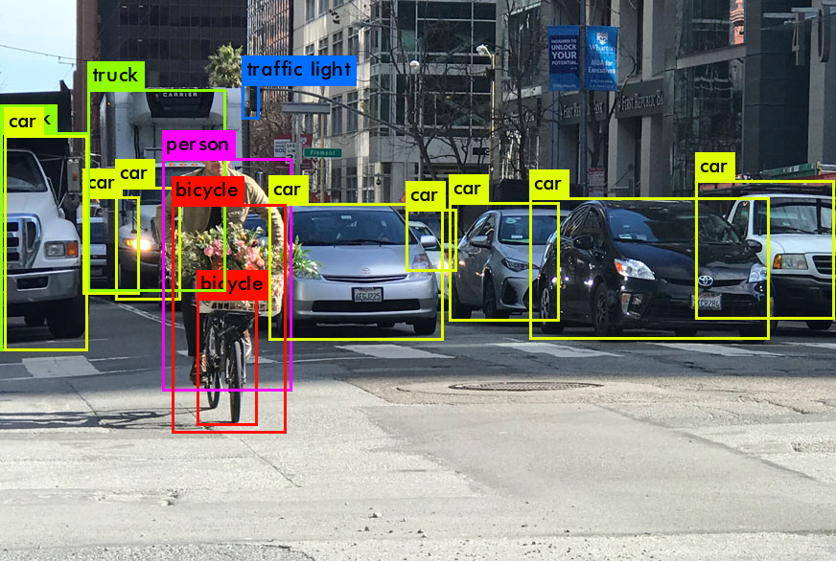
Object Detection with YOLO
Bounding Boxes
Detect and Classify Objects
Joseph Redmon link on YOLO at Ted Talk here
Source : Medium

Slide 17
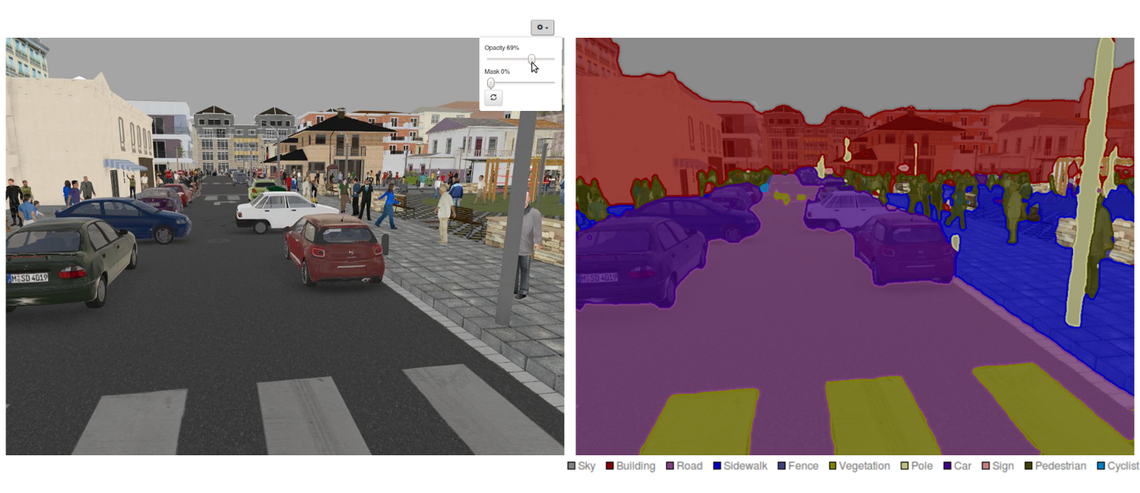
Image Segmentation using CNN
Source: Good Audience

Slide 19
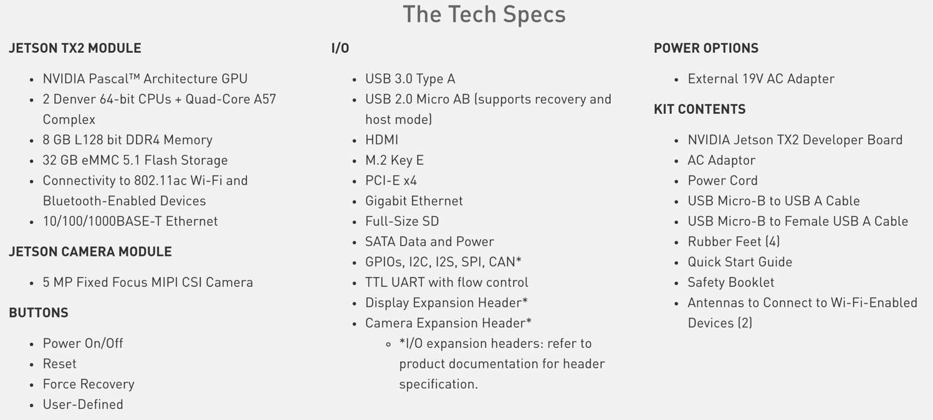

Slide 20
Demo!

Slide 21
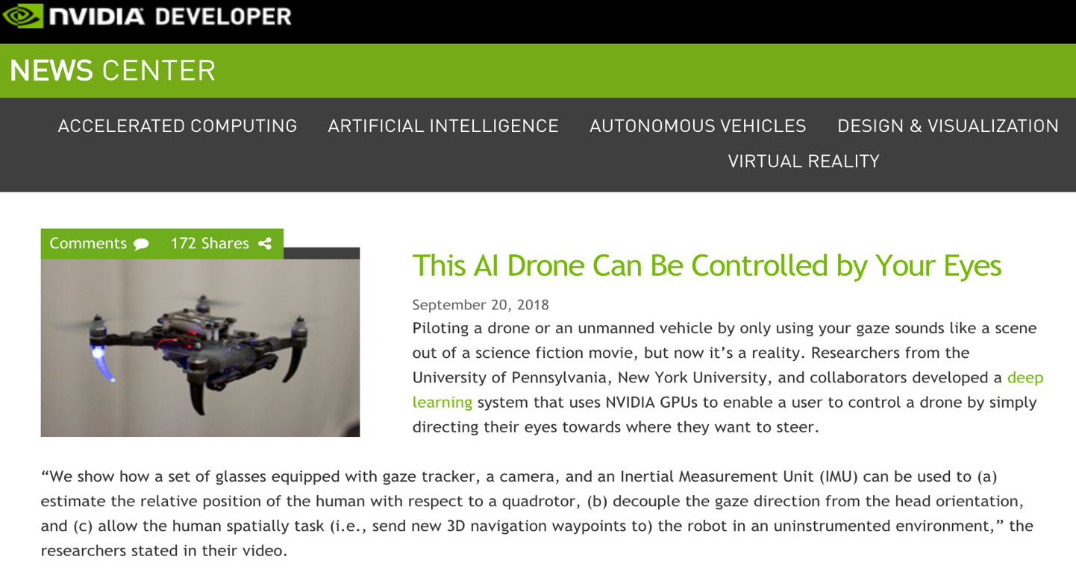
IEEE Link. YouTube Link to Smart Drone link - https://youtu.be/brF6TDqu1ec

Slide 22
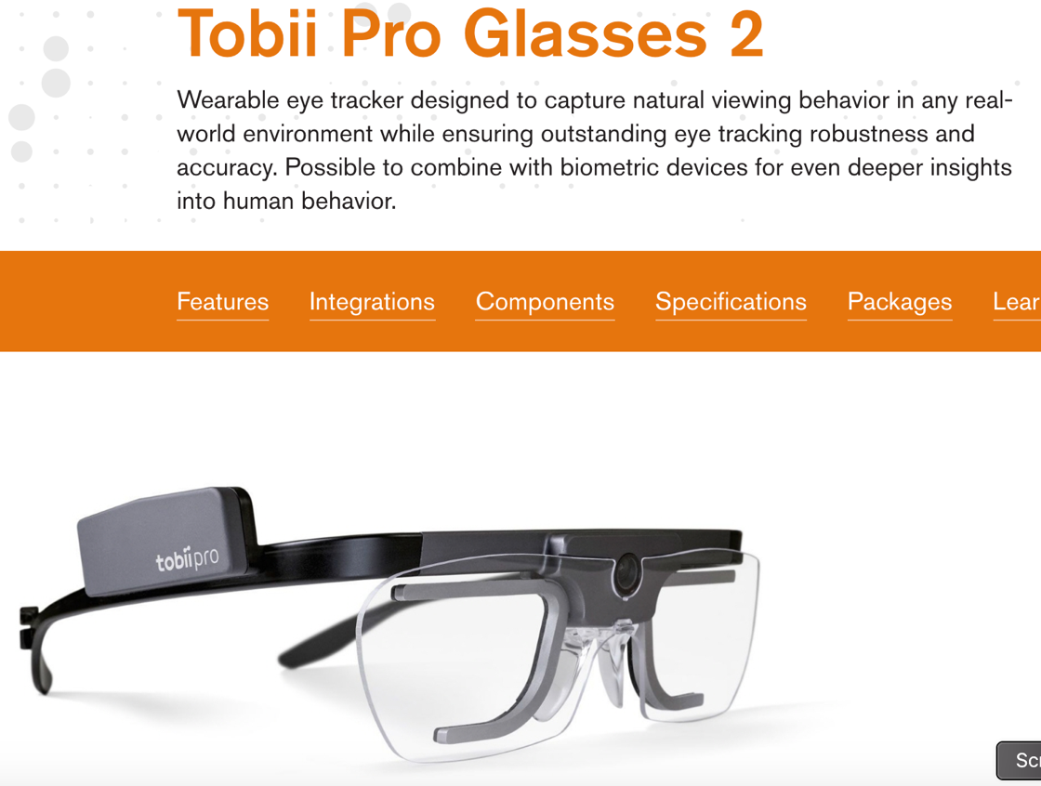

Slide 23
Deep Learning Tools
Frameworks
TensorFlow
Caffe
MS CNTK
PyTorch/Torch
MXNet
Chainer
Keras
Theano
Deeplearning4j
PaddlePaddle
MATLAB
CNN Architectures
LeNet
AlexNet
ZF Net
GoogLeNet
ResNets
cuDNN
DIGITS
DetectNet
TensorRT
RAPIDS
JETSON

