Slide 1
SIGCSE Workshop #108 - Programming Smart Contracts in Ethereum Blockchain using Solidity
Debasis Bhattacharya, JD, DBA – UH Maui College, HI
Mohammad Azhar, PhD – CUNY BMCC, NY
Mario Canul – UH Maui College, HI
Saxon Knight – UH Maui College, HI
Rajiv Malkan – Lone Star College, TX
Takashi Sugimura, PhD – UH Maui College, HI
http://maui.hawaii.edu/cybersecurity
debasisb@hawaii.edu
University of Hawaii Maui College
February 27, 2019
Supported by NSF ATE Award # 1700562

Slide 2
Agenda
Module 1 - Cryptocurrencies
Bitcoin Basics, Mining, Consensus, Security – (20 minutes)
Module 2 - Ethereum and Blockchain
Ethereum Basics, Cryptography, Wallets, Transactions – (20 minutes)
Module 3 - Smart Contracts
Smart Contracts and Demo – (15 minutes)
Break – (5 minutes)
Lab - Programming a simple Smart Contract using Solidity – (90 minutes)
Module 4 - Distributed Apps (DApps)
Transition to the classroom (30 minutes)
Next Steps…

Slide 3
What is Blockchain …. Bitcoin ? Who is Satoshi Nakamoto ?
Bitcoin revolutionized our concepts of currency and money. … 2008 Height of the banking crisis
Like the currency he created, the identity of Bitcoin’s creator Satoshi Nakamoto is virtual, existing only online.

Slide 5
Software, Game Theory and Cryptography
Separately these fields have existed for a long time, but for the first time they have intersected and morphed into Blockchain Technology
Game Theory is the “study of mathematical models of conflict and cooperation between intelligent rational decision makers”.
Is related to Blockchain because the Bitcoin Blockchain (public ) originally conceived by Satoshi Nakamoto had to solve a known game theory conundrum called the Byzantine Generals Problem

Slide 6
(1982)
Consensus Results including the Byzantine Generals Problem (1982) were developed to study systems like distributed databases

Slide 7
Cryptography Science is used in multiple places to provide security for a Blockchain network and rests on three basic concepts
Hashing
Keys
Digital signatures
Software has been developed that combines Cryptography with Game Theory to produce the overall constructs of Blockchain, where seeming uncertainty is mitigated with overwhelming mathematical certainty

Slide 8
Blockchains Fit in the Technology Revolution
Pre 1993 …. Internet browser introduced
Database ( IBM 1970) applications/ data storage, analytics
Centralized networks / client –server systems
Internet Era (1993-2010)
email / e- Commerce
Decentralized networks
Social networks
2010 - Present
High performance computing/ GPU
Distributed networks / cloud computing
Big Data/ AI and Machine Learning
Blockchain/ Bitcoin (10 years ago)

Slide 9
IBM’s database model stood unchanged until about 10 years ago, when the Blockchain came into this space with a radical new proposition:
What if your database worked like a network — a network that’s shared with everybody in the world, where anyone and anything can connect to it?
Blockchain calls this “decentralization.”
offers the promise of nearly friction-free cooperation between members of complex networks
adds value to each other by enabling collaboration without central authorities and middle men.
Jonny Brooks-Bartlett

Slide 10
No central nodes ..peer-to-peer

Slide 11
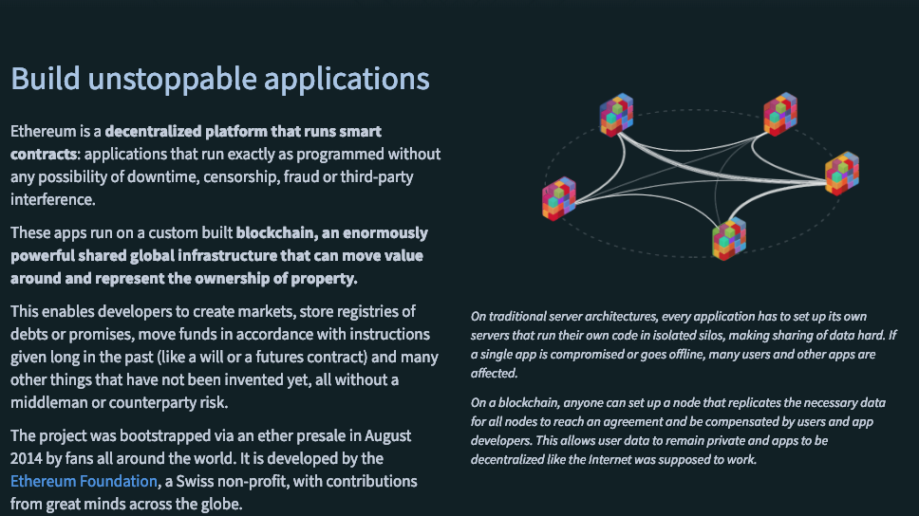

Slide 12
Blockchain Process… Decentralization
All nodes could be miners
No central nodes …. All the nodes are not connected to each other

Slide 13
Distributed Consensus
(not all nodes have all the information at the same time( Latency)

Slide 14
Bitcoin consensus works better in practice than the Byzantine Generals Problem (BGP theory)
The theory is important because it can help predict unforeseen attacks
Consensus works better for Bitcoin due to the additional conditions
Offers incentives
Embraces randomness
Doesn’t have a specific endpoint
Consensus happens over a longer time scale….. 1 hour

Slide 15
How Blockchain Works
Here are five basic principles underlying the technology.
1. Distributed Database
Each party on a blockchain has access to the entire database and its complete history.
No single party controls the data or the information. Every party can verify the records of its transaction partners directly, without an intermediary.
2. Peer-to-Peer Transmission
Communication occurs directly between peers instead of through a central node.
Each node stores and forwards information to all other nodes.

Slide 16
3. Transparency with Pseudonymity
Every transaction and its associated value are visible to anyone with access to the system. ( public key)
Each node, or user, on a blockchain has a unique 30-plus-character alphanumeric address that identifies it. (private key)
Users can choose to remain anonymous or provide proof of their identity to others. (signatures) Transactions occur between blockchain addresses.
4. Irreversibility of Records
Once a transaction is entered in the database and the accounts are updated, the records cannot be altered, because they’re linked to every transaction record that came before them (hence the term “chain”).
Various computational algorithms and approaches are deployed to ensure that the recording on the database is permanent, chronologically ordered, and available to all others on the network.

Slide 17
5. Computational Logic
The digital nature of the ledger means that blockchain transactions can be tied to computational logic and in essence programmed.
users can set up algorithms and rules that automatically trigger transactions between nodes.
Data Security
Keys
Signatures
Hashing
Redundancy
Improved workflow

Slide 18
p = public key
q = private key
p*q = N also publicly shared
m = message
(m)
(m)
s = q*m
(q)
(p)
signature = f(message, private key) ….unique for every transaction
Verify = f( signature, message, public key) = { true or false}

Slide 19
Hash function
Takes any string as input
Creates a fixed size output ( 256 bits for Bitcoin)
Efficiency Computable
Security properties
Collision – free
Puzzle- friendly…. consensus

Slide 20
If H(x) = H(y) then x = y
compare hashes instead of long messages

Slide 22
The SHA (Secure Hash Algorithm) is one of a number of cryptographic hash functions. ... -algorithm that generates an almost-unique, fixed size 256-bit (32-byte) hash. (a “bit” is the smallest unit of storage 1 or 0/ a byte is 8 bits & encodes a single character 256/8 = 32)
Creates a unique character set of fixed length / hash
Not encryption… cannot be decrypted to original text
The entire Library of Congress can be “hashed”
Regardless of the length of the data ( entire Library of Congress)…. The length of the hash value is fixed

Slide 23
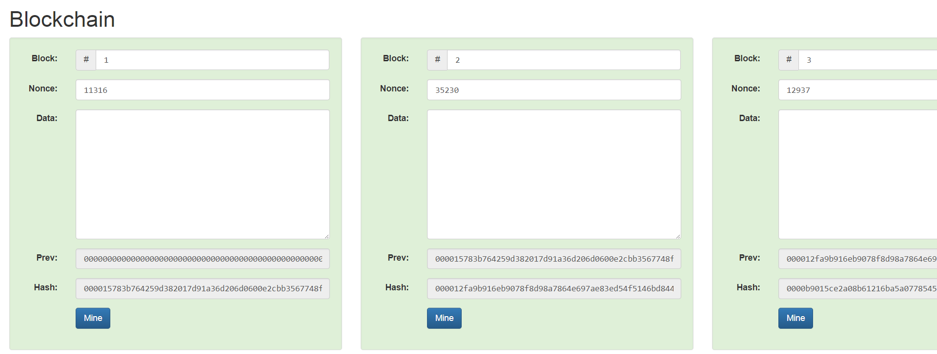
Blockchain Demo: Interactive: https://anders.com/blockchain/blockchain.html
Block 1: Genesis Block
req: start with “0000”

Slide 24
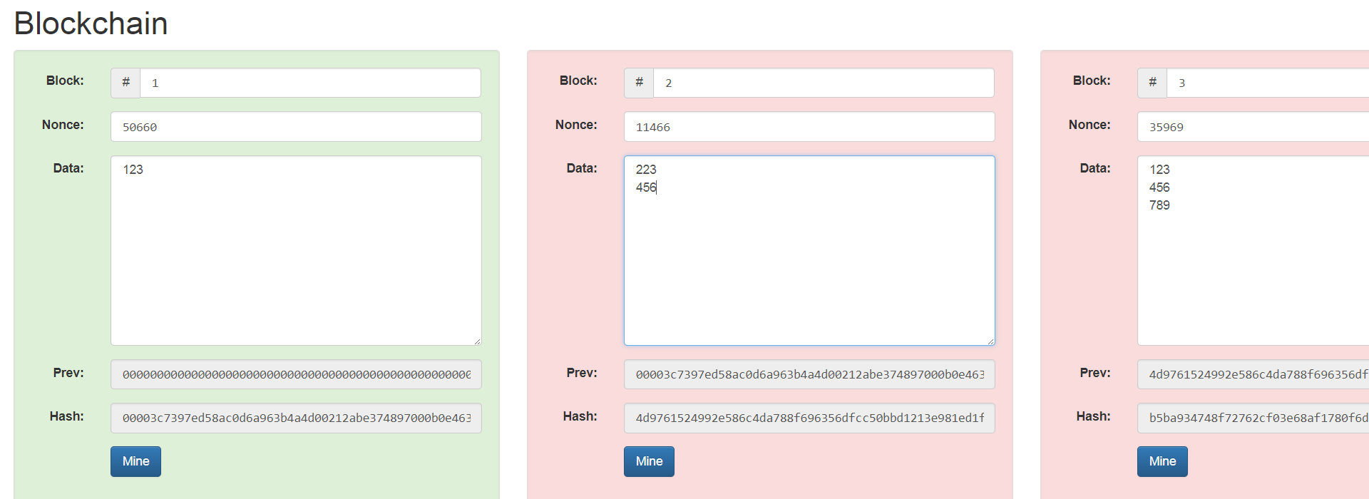
Data: 123 Altered 223
456 456
In the demo there is an example of 3 “Peers” and a demonstration of consensus management

Slide 25
The hash output, or fingerprint, is actually what’s used as the “previous block” reference.
One result of this is that there’s no way to switch out a block in the middle of the chain, because the hash value for the new block would be different, and the next’s block reference would no longer point to it.
Even more importantly, a block cannot be solved before the previous block is solved. The previous block reference is part of the text that goes through the hash function, so any changes to it would require resolving.

Slide 26
solving a block involves trying to get the cryptographic hash of the block to be below a certain value, and you do that by trying different random numbers . Once solved, the hash output is like a fingerprint that uniquely identifies that block. If even a single character in the block is changed, the block’s hash would be completely different
Specified by “Blockchain” creator
OK to proceed

Slide 27
References
Byzantine Generals Problem – Lamport, Shostak, Pease, 1982
www.Ethereum.org – Ethereum Project – founded by Vitalik Buterin in 2013
https://gavwood.com/paper.pdf - Ethereum paper by Gavin Wood
Ethereum White Paper and Smart Contracts – by Vitalik Buterin in Nov 2013
XRP Ledger Consensus Protocol – Chase and MacBrough, 2018
www.hyperledger.org – The Linux Foundation Project – Hyperledger
https://anders.com/blockchain/ - Blockchain Demo
https://www.ibm.com/blockchain - IBM Blockchain
https://aws.amazon.com/blockchain/ - Amazon AWS Blockchain
https://azure.microsoft.com/en-us/solutions/blockchain/ - MS Azure Blockchain

